Slide 1
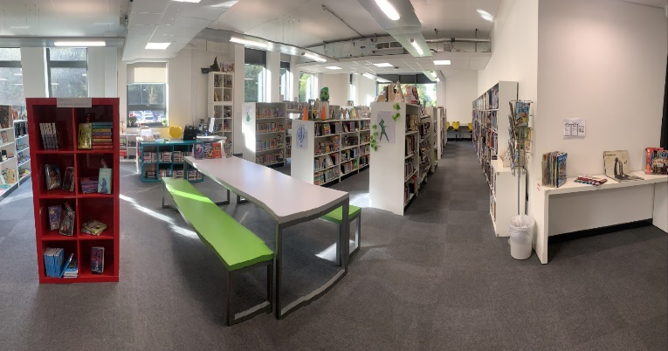
WCA Library Welcomes you!

Slide 2
As we find ways of making sure everyone can use the library….
We have come up with a few ideas

Slide 3
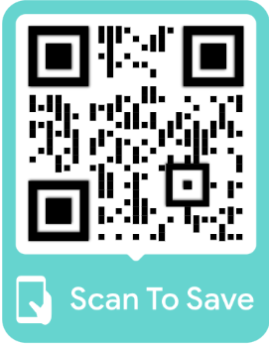
All students can use the library by collecting a QR Code pass
The passes are released daily, and you can get them from the library from 8:15am
Choose a break or lunch time pass and spend some time exploring our shelves, reading, revising or playing games

Slide 4
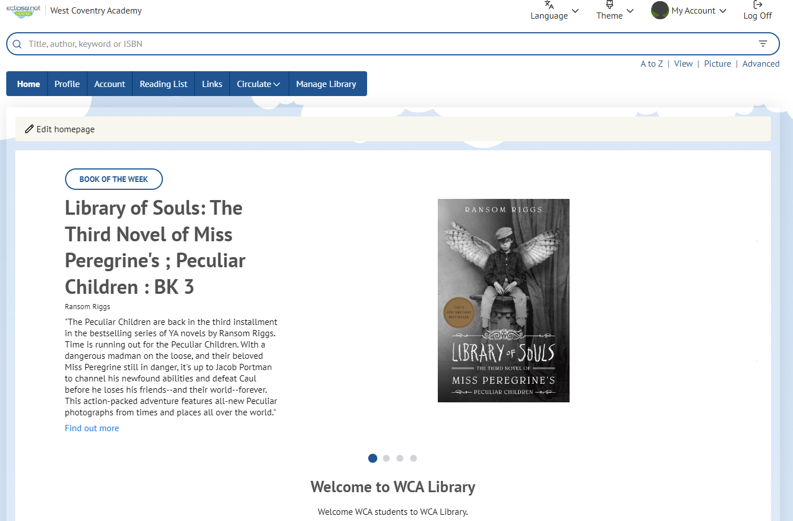
You can also access the library system
to explore, choose and reserve books.

Slide 5
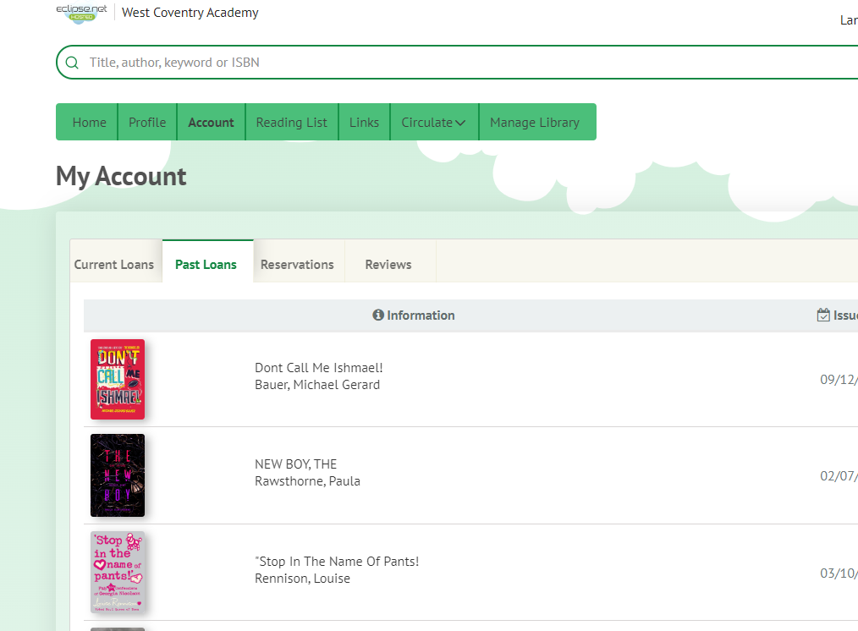
Check your account to see what you have loaned, what you have read and reserved.

Slide 6
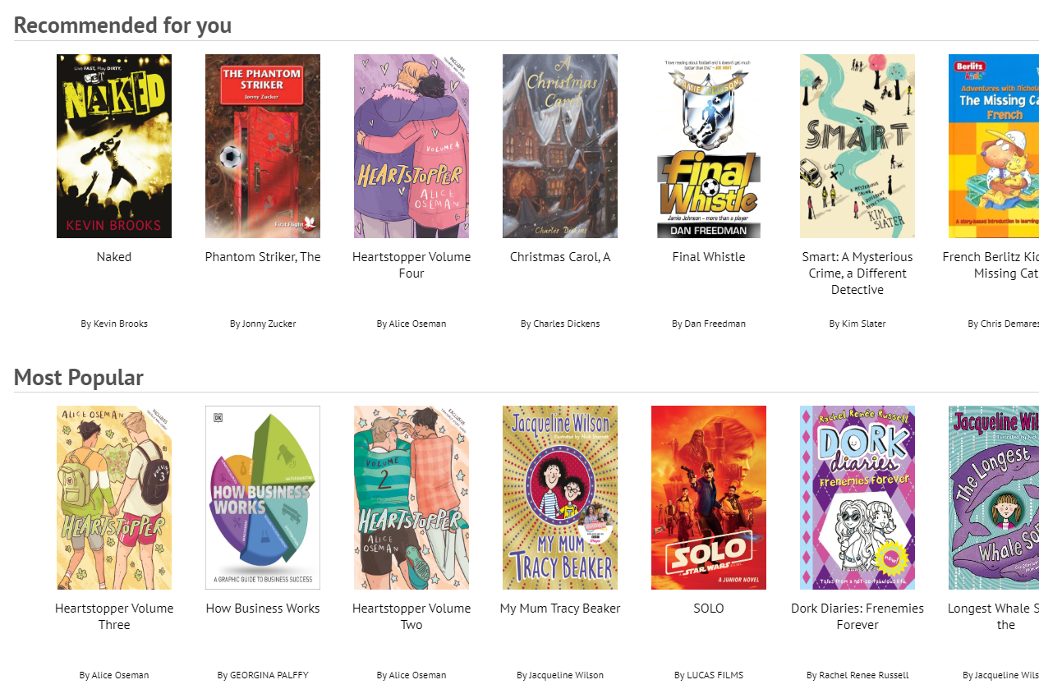
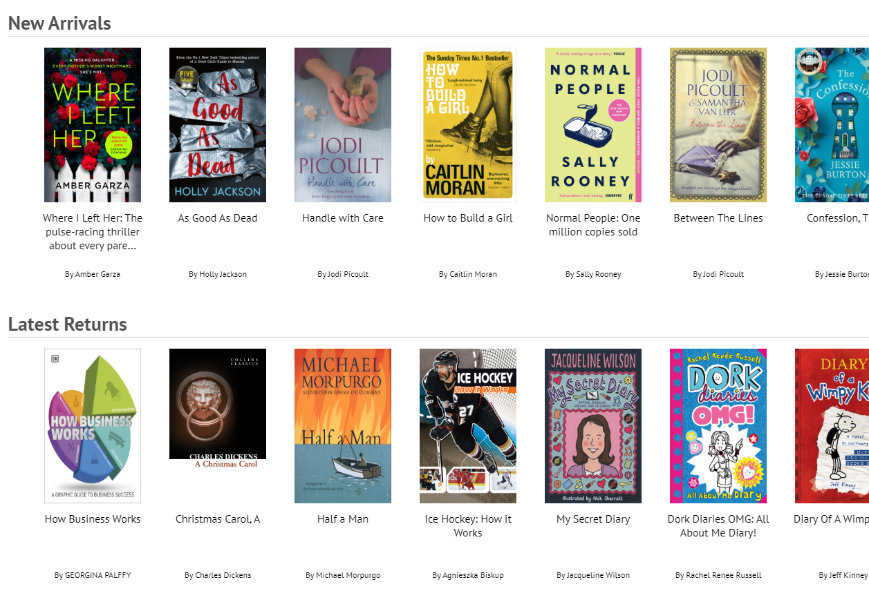
Try something new
Finding out what books the library has is easy!
Search
title/author
Check out new books
See what others have read

Slide 7
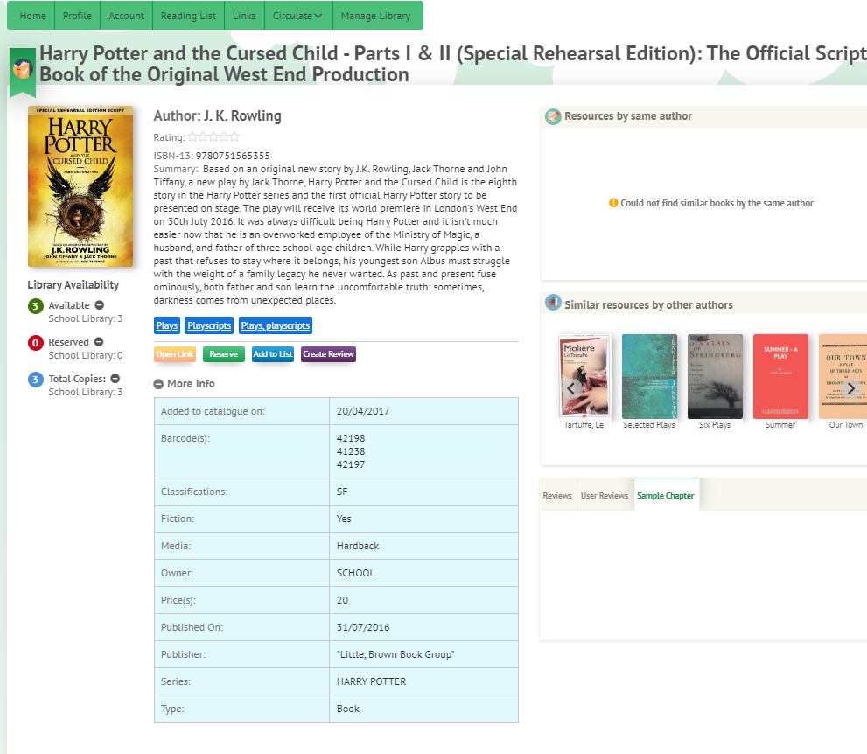
Select a book to:
Find out more… Add to wish list… Write a review… What is similar…
Similar authors…

Slide 8
8
Found a book you want to read? Press RESERVE – The librarian will notify your tutor when it is ready for collection
Choose
Reserve
Collect

Slide 9
Do you want to just browse and loan a book?
Come down before school & we will help you find a perfect book!
Ask at the check in desk during break and lunch
Come down after school & to find a book to take home!

Slide 10
Logging in is easy!
Type in your browser: u004889.microlibrarian.net
User Name : ***** (Your library number)
Password : ***** (Your library number)
You can change your password – but REMEMBER TO WRITE IT DOWN!
Ask the Librarian for
Your library number

Slide 11
What can you do in the library?
We have over 25 thousand books! You can read, browse, take and return books
You can study, research, revise and do project work
We also have an after-school club for doing homework
You can play games – Ask our Games Master to help you to choose
Watch a movie on Fridays
The library is a great space for making friends, meeting up and trying new things – try to visit regularly to get involved

Slide 12
What can’t you do in the library?
Eating or Drinking
Use your mobile phone
Play music
Move the chairs - they are to be kept in the designated areas
Chase or run
Make sure you…
Place bags and coats in lockers or on the green benches
Keep your voices low if you are in a group
Look after the books – do not push books back on shelves
Look after our games
We want to make sure the space & experience is as good as your first visit, so we have created some rules to make sure that it is.
You will be asked to leave if do not respect the library rules.

Slide 13
Have you got a library book to return?
Books are issued for 2 weeks – if you need it for longer, then just pop down to the library to extend the date
A Quick Return Trolley is located outside the library
Books that are late back generate an overdue letter to your parents. If you have a problem returning your book, speak to the Librarian so she can help.
Damaged and lost books have a £5 replacement charge

Slide 14
So, just to recap…
8am - Browsing
8:15am - Passes issued
Break time – with a pass
Opening Times
Lunchtime – with a pass
3:15pm – Homework club

Slide 15
Thanks for listening!
Ms Wilkins
WCA Librarian

