Slide 1


GCSE
Wednesday 13 March 2019
Parent
Workshop

Slide 3

Top 10 tips to support your child through their exams

Slide 4

How can you help your child
and prepare them to perform?
Being a role model
Help them set goals
Keep them active
Healthy eating
Time out
Sleep patterns
Unplugging
Staying cool & calm
Be informed
Belief

Slide 5

1. Being a role model
Set a good example by modelling the behaviour you want your child to adopt…
Planning for the week
Eating healthily
Keeping hydrated
Leading an active life
Staying calm
Being organised
Good sleep habits

Slide 6

2. Goal Setting
Keep their revision planner printed and displayed in their room / on the fridge
Give positive reinforcement
Talk about ‘why’ and ‘what’ they want to achieve

Slide 7

20-30 minutes per day
3. Keeping Active
Carry out exercise in manageable chunks e.g. 2 x 15 min sessions throughout the day OR 3 x 30 mins a week
Plan to do active things together on a weekend
Help them plan out their weekly exercise schedule in advance
After exercise your brain functions well, so encourage a revision session afterwards

Slide 8

4. Healthy Eating
Avoid high sugary and fatty foods or drinks
Encourage them to eat breakfast everyday
Hydration is key to brain functioning so make sure your child carries a bottle of water with them

Slide 9


5. Time Out
Encourage them to build in opportunities to take some time out every week, away from study. For example:
Going out for food
Seeing friends
Having a bath
Listening to music
Reading a book
Doing a hobby
Going shopping
Going to the cinema

Slide 10

6.Sleep Patterns
Young people need between 8 – 9 hours sleep per night
Help your child create a relaxing evening routine
Make sure they don’t eat too late at night
Avoid giving them caffeine or sugary drinks late at night
Make sure they don’t work or
revise too late before going to
bed
Encourage them to switch off
from social media / technology
at least an hour before bedtime

Slide 11

7. Unplugging
Help them switch off from technology at least 30 mins- 1 hr before going to sleep
Make sure they put their phone away & on silent, while they are revising
Choose some time each day/
week to switch off and unplug
from technology with them

Slide 12

8. Staying Cool & Calm
Set a good example by staying calm yourself
Help them plan out coping strategies to deal with their stress
Give them positive distractions away from studying

Slide 13
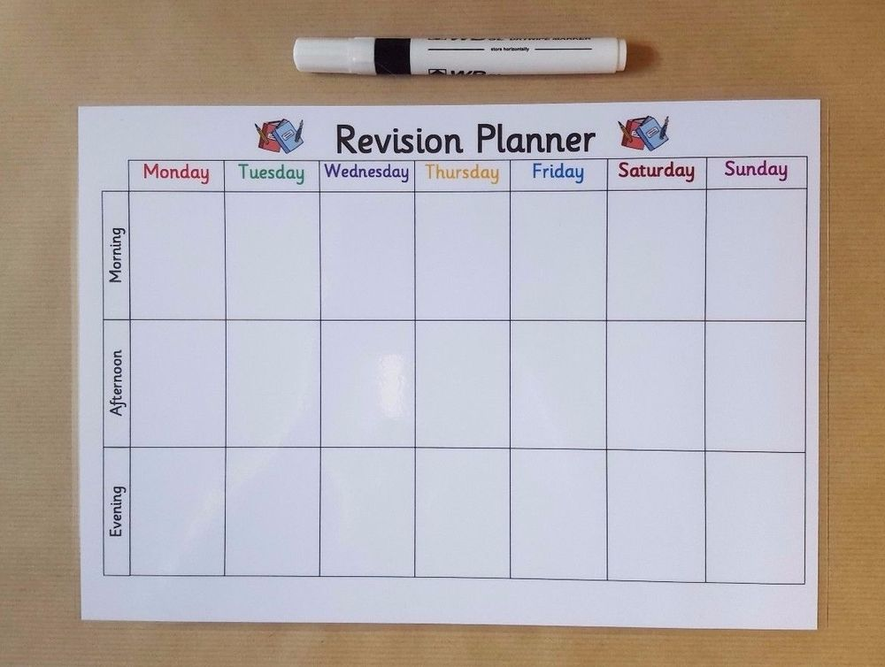
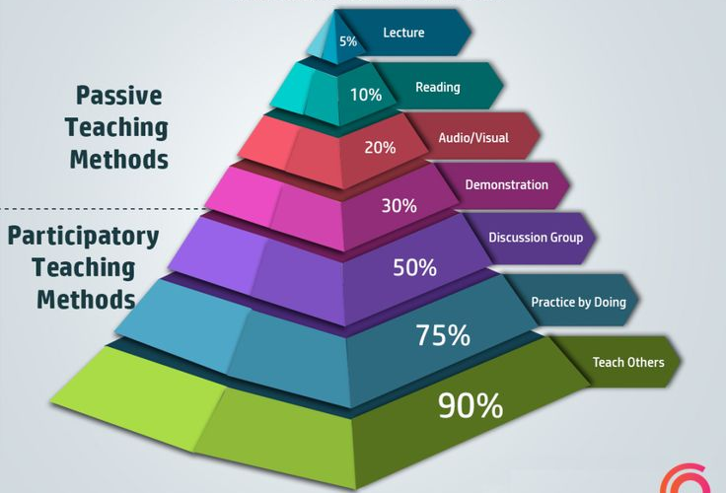
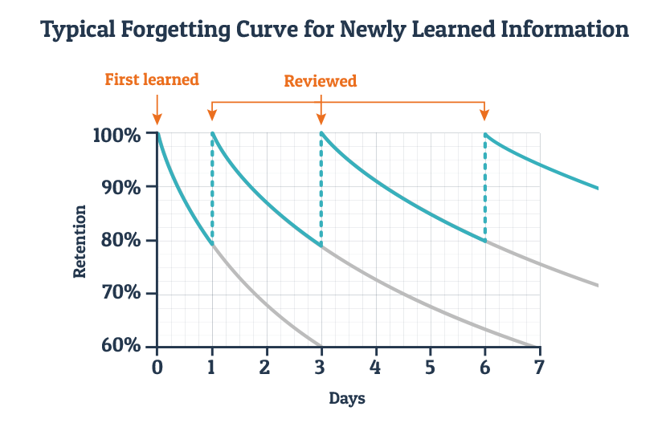
9. Be informed

Slide 14

10. Fail successfully
Give them positive reinforcement
(“You can’t do this yet”)
continuous improvement vs target grades
Celebrate any successes and reward them e.g. if they have achieved their mini-goals
Show them how proud of them you are

Slide 15

Further reading:
Mindset: the new psychology of success (Carol Dweck, 2012)
The Teenage Guide to Stress (Nicola Morgan, 2014)
Blame My Brain: The Amazing Teenage Brain Revealed
(Nicola Morgan, 2013)
https://www.relate.org.uk/blog/2015/5/20/helping-your-teen-cope-exam-stress
https://www.familylives.org.uk/advice/teenagers/school-learning/exam-stress/

Slide 16

Further links:
www.bbc.co.uk/bitesize
www.rewardinglearning.co.uk
www.s-cool.co.uk
https://getrevising.co.uk/
https://www.senecalearning.com/
www.studyskillszone.co.uk
www.fastpapers.co.uk
http://westcoventryacademy.org/learning/exams/revision_advice.aspx

