Slide 1
WCA Library Welcomes you back!

Slide 2
As we find ways of making sure everyone can use the library safely….
We have come up with a few ideas

Slide 3
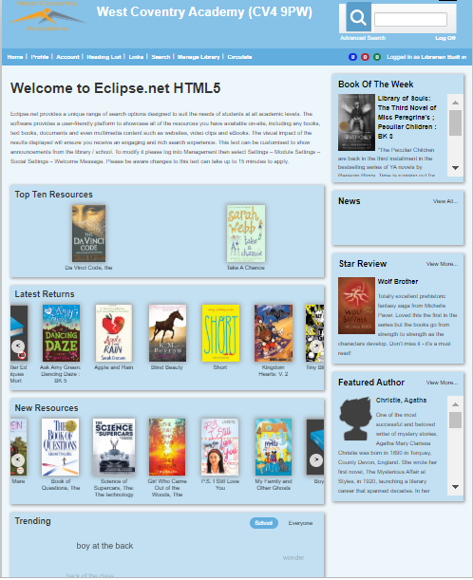
You can now access the library system to explore, choose and reserve books.

Slide 4
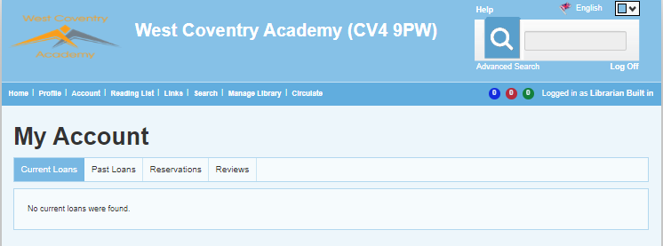
Check your account to see what you have loaned, what you have read and reserved.

Slide 5
Search
title/author
Finding out what books the library has is easy!
Try something new
See what others have read
Check out new books

Slide 6
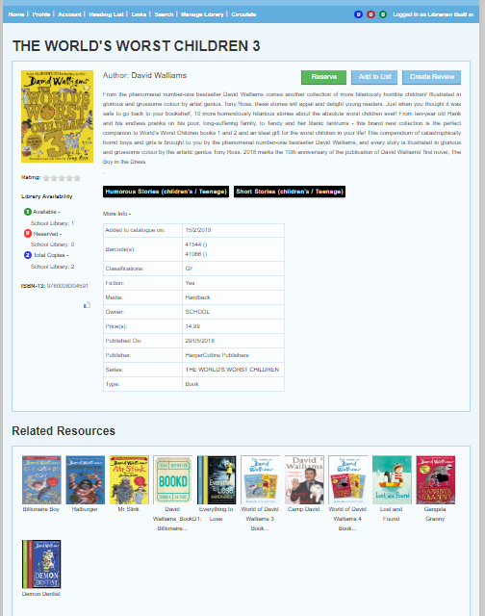
Select a book to:
Find out more… Add to wish list… Write a review… What is similar…
Similar authors…

Slide 7
Found a book you want to read? Press RESERVE – The librarians will deliver your book to your tutor room
Choose
Reserve
Deliver

Slide 8
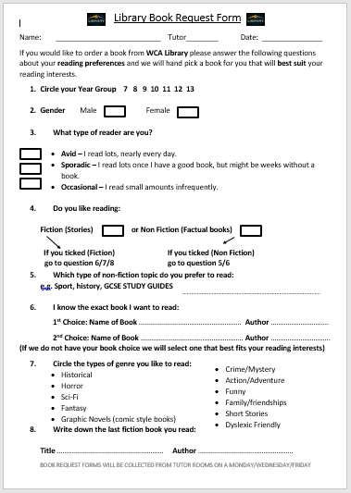
Would you rather use the Library Book Request forms?
Ask your tutor for one
Ask librarians on Edmodo
Email library
Librarians will deliver
the books to your
tutor rooms

Slide 9
Have you got a library book to return?
We are giving a CHOCOLATE TREAT to the first 100 students who return their books
The collection box is located outside the library.
Please return your book as soon as possible. Overdue letters will be with your tutors by this Friday!

Slide 10
Logging in is easy!
Type in your browser: u004889.microlibrarian.net
User Name : ***** (Your library number)
Password : ***** (Your library number)
You can change your password – but REMEMBER TO WRITE IT DOWN!

Slide 11
Request it!
So, just to recap…
Receive it!
Read it!
Return it!

Slide 12
Thanks for listening!
Ms Wilkins and Mrs Russell
WCA Librarians

